Slide 1
Can Art Save Us?
I’m starting the first national and international conversation about courage and curiosity. Season One launched.
What do these qualities really mean and why does it make a big difference to our mental, societal and democratic health?
I talk to award winning and diverse artists to explore these qualities in their lives and work from national and international perspectives both to inspire and learn.
Free to listen and subscribe, Season One
https://canartsaveus.podbean.com/
If the arts invite and cultivate courage and curiosity, Can Art Save Us?

Slide 2
Mental, Societal & Global Health
This podcast raises a new spotlight on courage and curiosity, language and cultural prejudice, automatic thinking, wired in bias and coming off of auto pilot. Why? To reclaim our health.
Understanding courage and curiosity raises a new conversation about health and self-empowerment in response to the global epidemic of mental illness and loneliness, the polarization of our communities, global conflict and the loss of democratic and human rights.
The Arts help us cultivate courage and curiosity often coming from a place of vulnerability, fear, disadvantage and discrimination, all of which are shared by the guests in the series.
When were you last curious? How often are you pushed digitally without making a choice first?

Slide 3
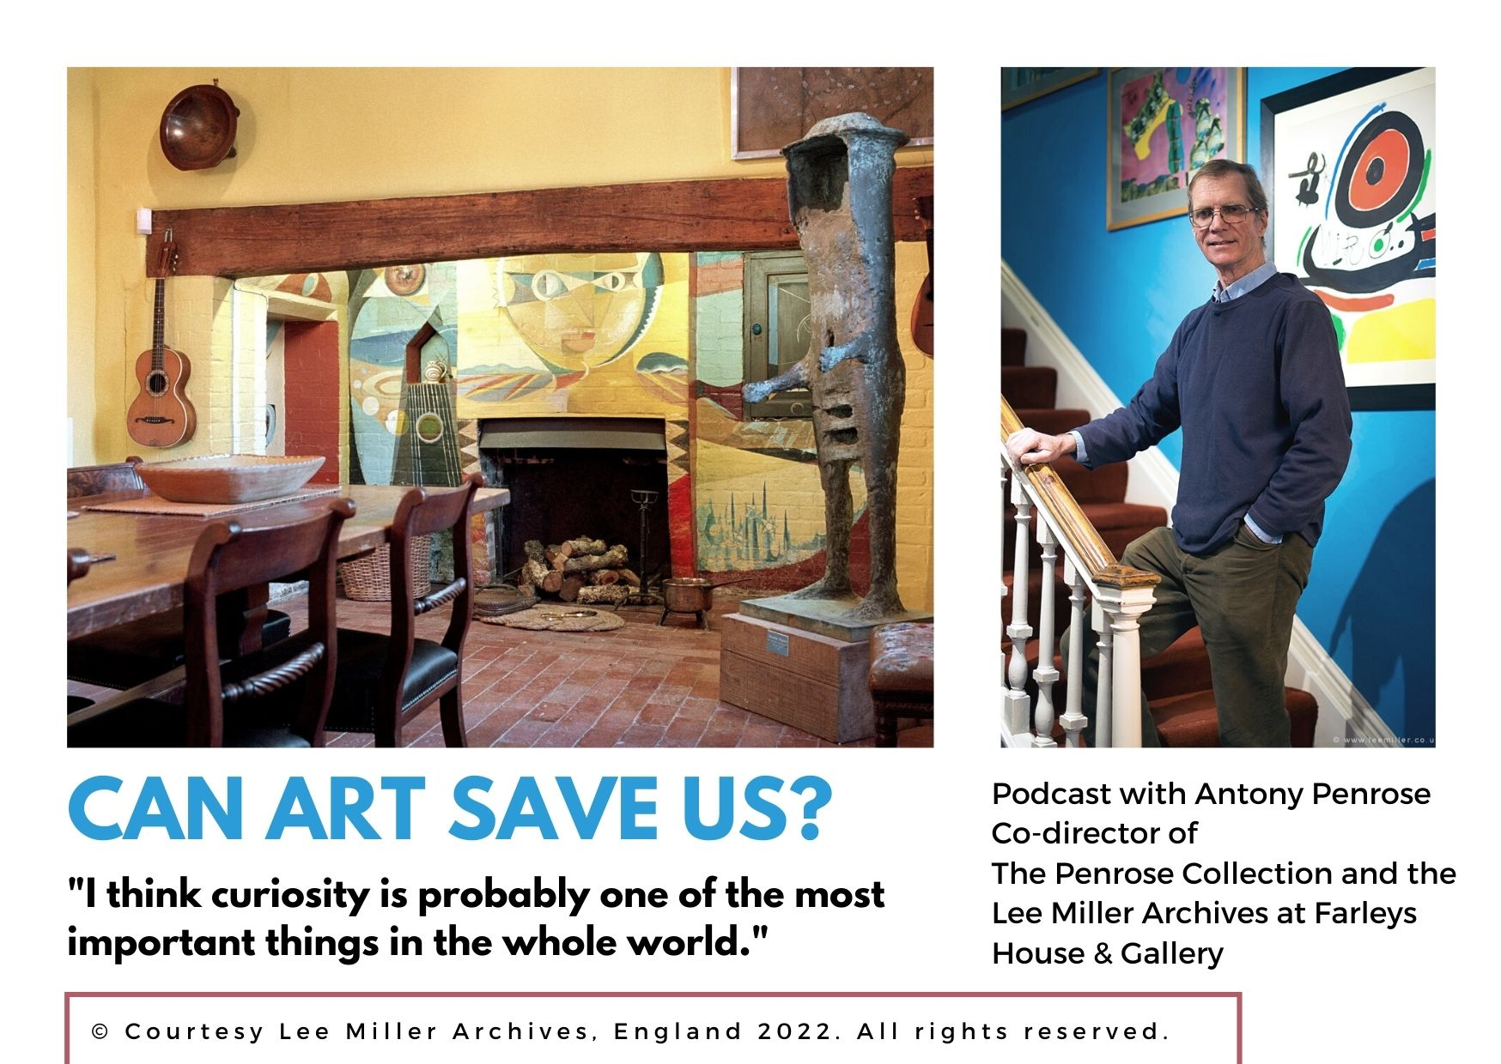
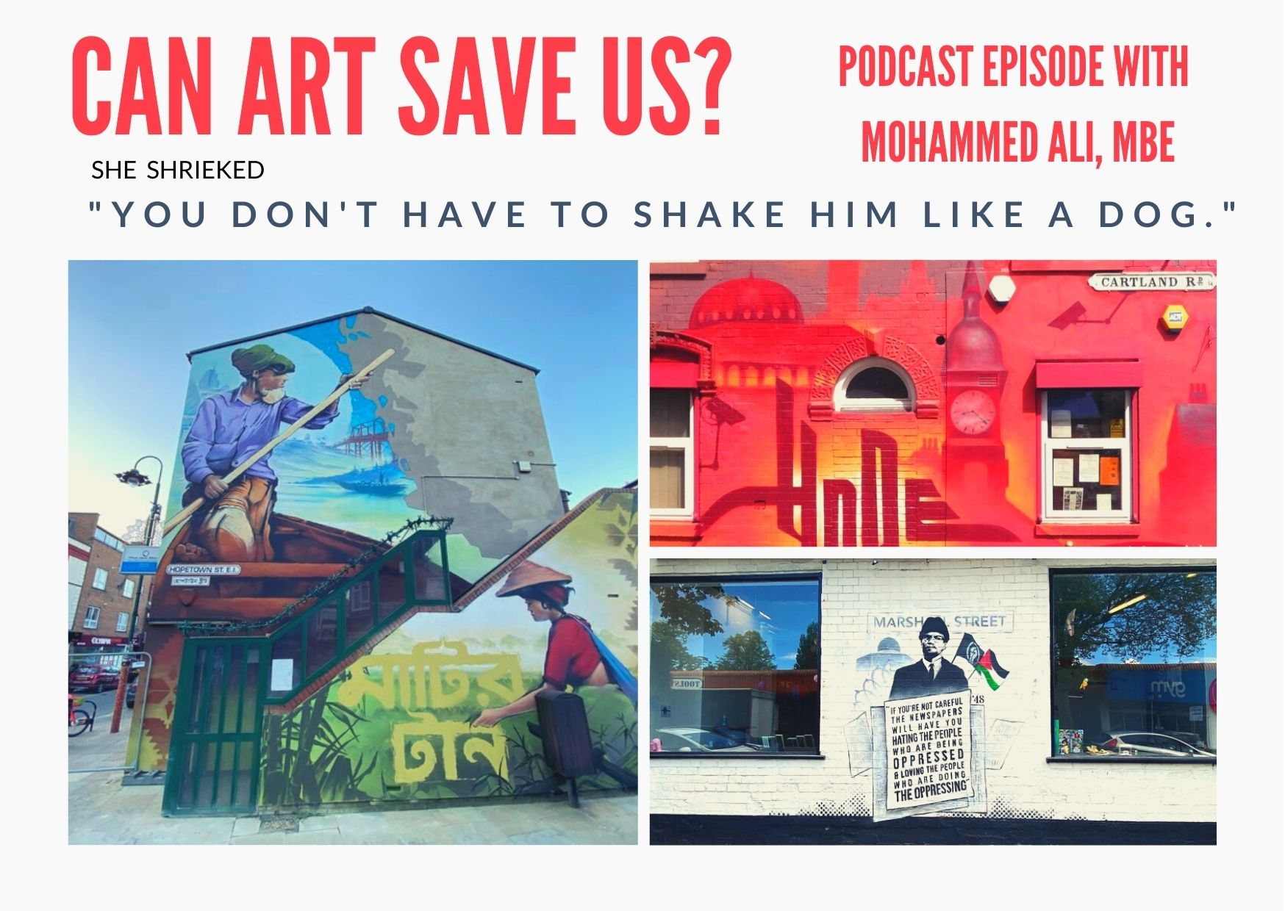
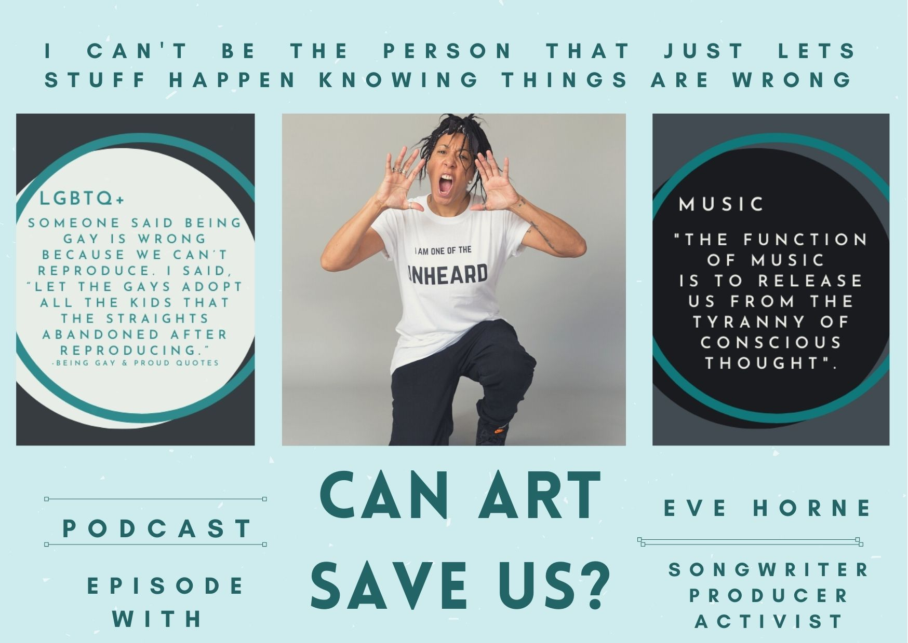
SEASON ONE

Slide 4
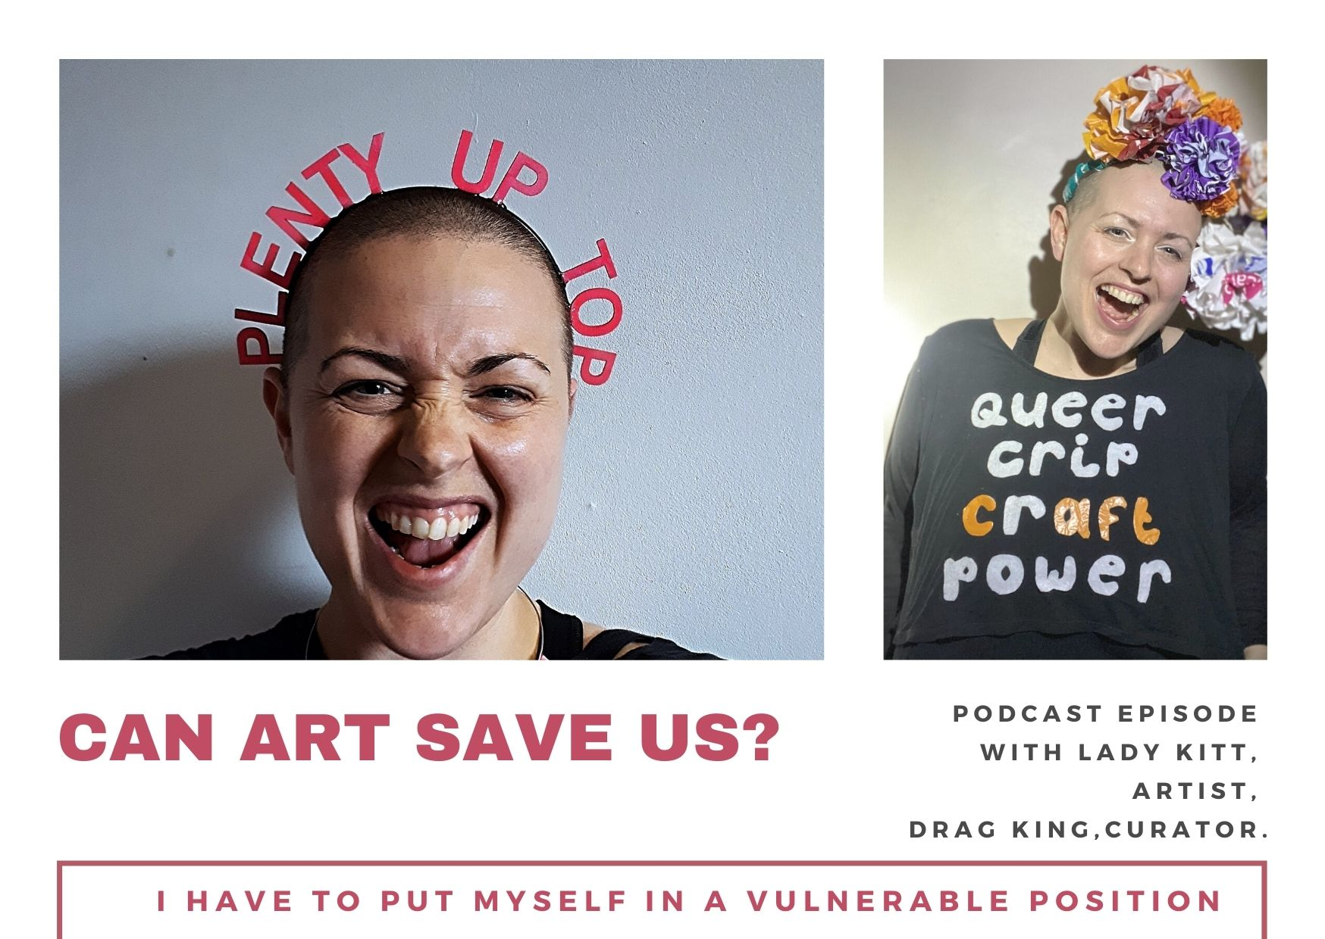
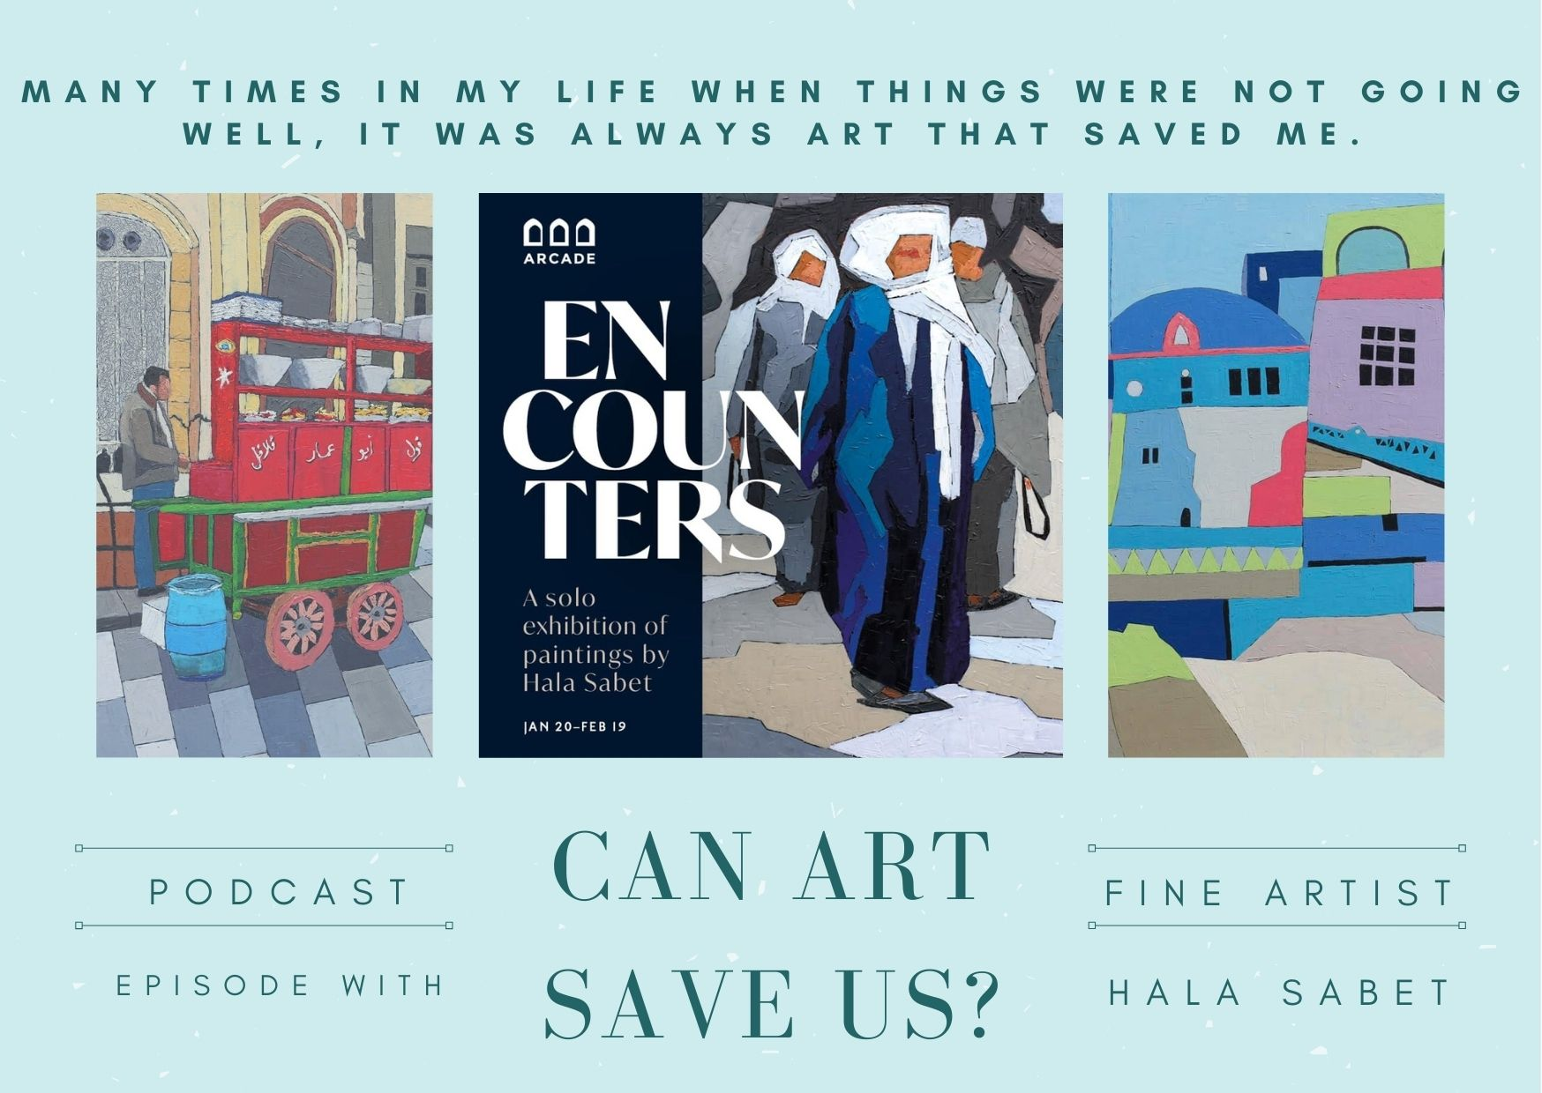
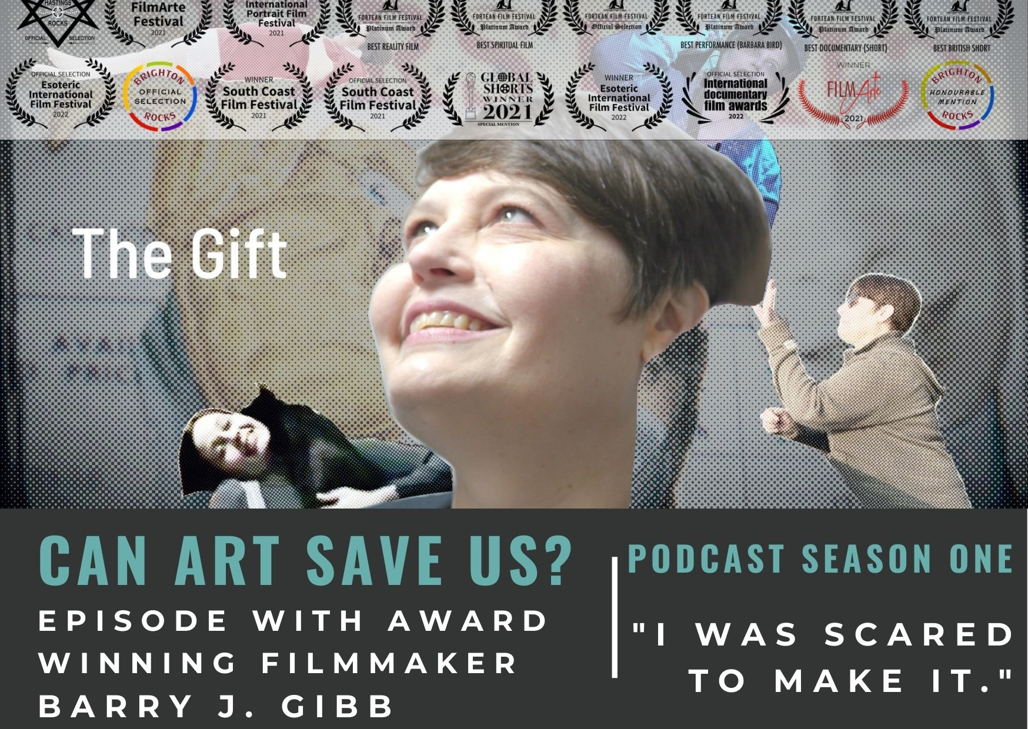
SEASON ONE

Slide 5
GUEST SUMMARY SEASON 1,2,3 8 EPISODES PER SEASON
SEASON ONE
Antony Penrose – Co-director of The Penrose Collection and the Lee Miller Archives at Farleys House & Gallery. Oscar winner, Kate Winslet stars as Lee Miller, Antony’s mother, in the forthcoming film ‘Lee,’ depicting her life as a WWII frontline photographer.
Mohammed Ali, MBE – Grafitti artist with ground breaking national & international commissions including the Vatican and immersive theatre productions.
Lady Kitt – Drag King ‘international superstar’ and socially engaged artist with worldwide projects.
Otis Mensah – The UK’s first hip-hop poet laureate, live performances include Glastonbury.
Marije Nie – Classically trained musician and ‘tap dance poet’ featured in her Ted Talk and award winning documentary One Million Steps. Marije danced in the explosive protests of Gezi Park, Istanbul.
Eve Horne – Musician, touring with major boy bands to driving trains to co-writing for major artists to her Unheard campaign for equality in the music industry.
Hala Sabet – Egyptian fine artist and sculptor. Hala left her career as the most senior, Egyptian woman at the multi-national gas and oil giant Shell to pursue art.
Barry Gibb – Multi award winning filmmaker and neuro-scientist exploring time, life and death. His end-of-life film ‘The Gift,’ has won over 15 awards.

Slide 6
GUEST SUMMARY SEASON 1,2,3 8 EPISODES PER SEASON
SEASON TWO, publishes late July.
Marwa Al-Sabouni - Syrian architect and acclaimed writer on architecture maintaining peace. Her TED Talk has been viewed over 1 million times, and Prospect Magazine named her as one of the Top 50 thinkers around the World.
Michael McMillan - playwright, artist, curator, academic, known for The West Indian Front Room at the Geffrye Museum. His plays explore family, identity and generation in a migrant context.’ On Duty’ was made into a Channel 4 docu-drama.
Daryl Beeton - high-profile advocate for disabled artists. Creates accessible theatre through co-creation, mischief and merriment, nationally and internationally.
Jo Howell - working class, photographic artist. Jo lives with fibromyalgia and works with groups living with dementia and autism. At the Bowes Museum she foregrounded the true story of Countess Mary Eleanor Bowes, a victim of violent domestic abuse and important botanist. Jo is raising the role of women in the 1985 miner’s strike for Sunderland Museum.
Tarek Zaidieh - violinist for the Orchestra of Syrian Musicians, collaborated with Daman Albarn, lead singer of Blur and co-founder of Gorillaz. The violin is his second heartbeat and music is a mission for peace.
Bobby Brown - a creative producer, artist manager and rising architect of community projects, culture and equal access in the City of Brighton. Bobby is behind household name, singer Eli Ingram and he’s at Glastonbury this year with Frankie Sew & Harvey Gunn.
Marice Cumber – a radical ceramicist, her giant cups carry messages of raw, personal emotions and sell out fast. Marice also directs Accumulate, a charity delivering creative workshops and scholarships for homeless youths.
Maya Youssef – Syrian composer and virtuoso hailed as ‘queen of the qanun,’ disseminating the healing power of music. Commissioned by Opera North, the British Museum and has performed at the BBC Proms.
SEASON THREE Guests confirmed, 5 scheduling tbc, publishes late September
Scott Shillum and Steve Wallington - launched The Photography Movement after they both experienced tragic losses to suicide. In collaboration with photographer Charlie Clift and Mental Health UK, they presented ‘Let’s Talk,’ portraits with well-known faces inscribed with their mental health experience.
Dr. Daryna Momot - artist & founder of Cittart supporting Ukranian artists with resources and shelter during the war.

Slide 7
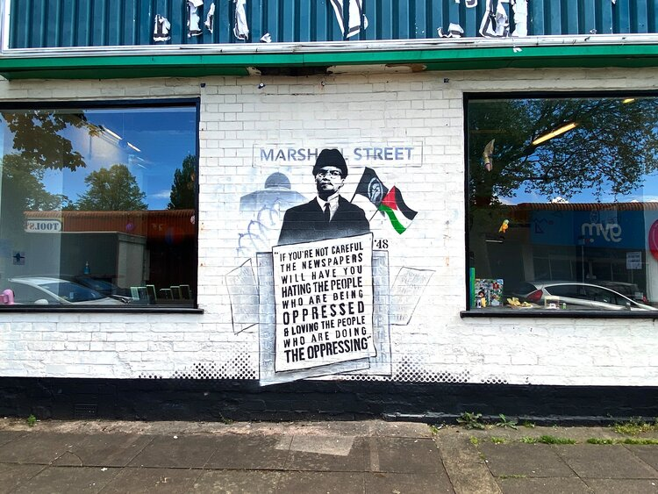
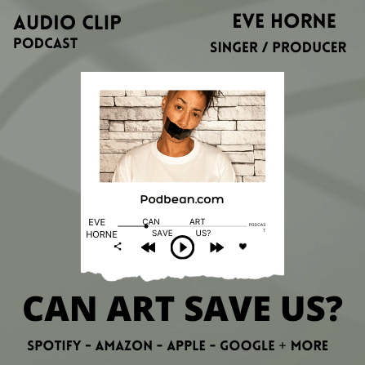
Creative, Living, Research Oral Documentary Diverse but Unifying Themes Two Clear Lenses, Curiosity & Courage
Editing. No editorial judgements are made. Edits are around wifi and bandwidth issues, the focus is on authenticity.
All interviews are trauma sensitive.
This is a power shift in language and self-help offering a resource for research to feed into new practices for mental and societal health, education and innovation, community and cultural management, peace and democracy.
Exploring research associations and partnerships in the areas of arts and wellbeing, health and socio-linguistics.
Socio-linguistics. The impact language has on our lives, cultural and demographic interpretations of courage and curiosity – bias and prejudice – opening the mind and why it’s important.
Expansion to video, exploring what courage and curiosity means with children, different age groups, discover amusing and surprising interpretations to help increase engagement and insights to meaning.
Mainstream engagement. Courage and curiosity is relatable, entertaining; meaningful life stories with purposeful research value.
Curiosity didn’t kill the cat. The cat wasn’t curious enough.

Slide 8
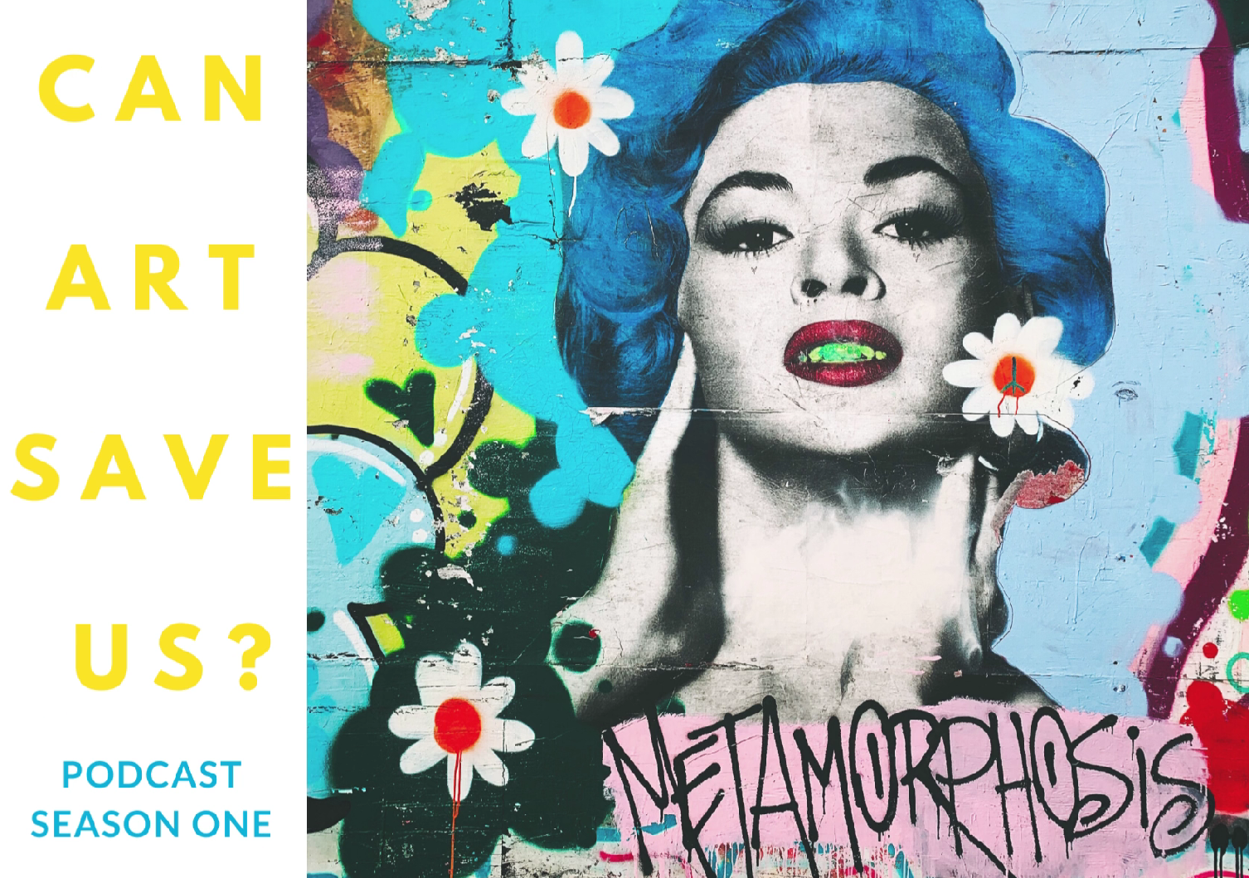
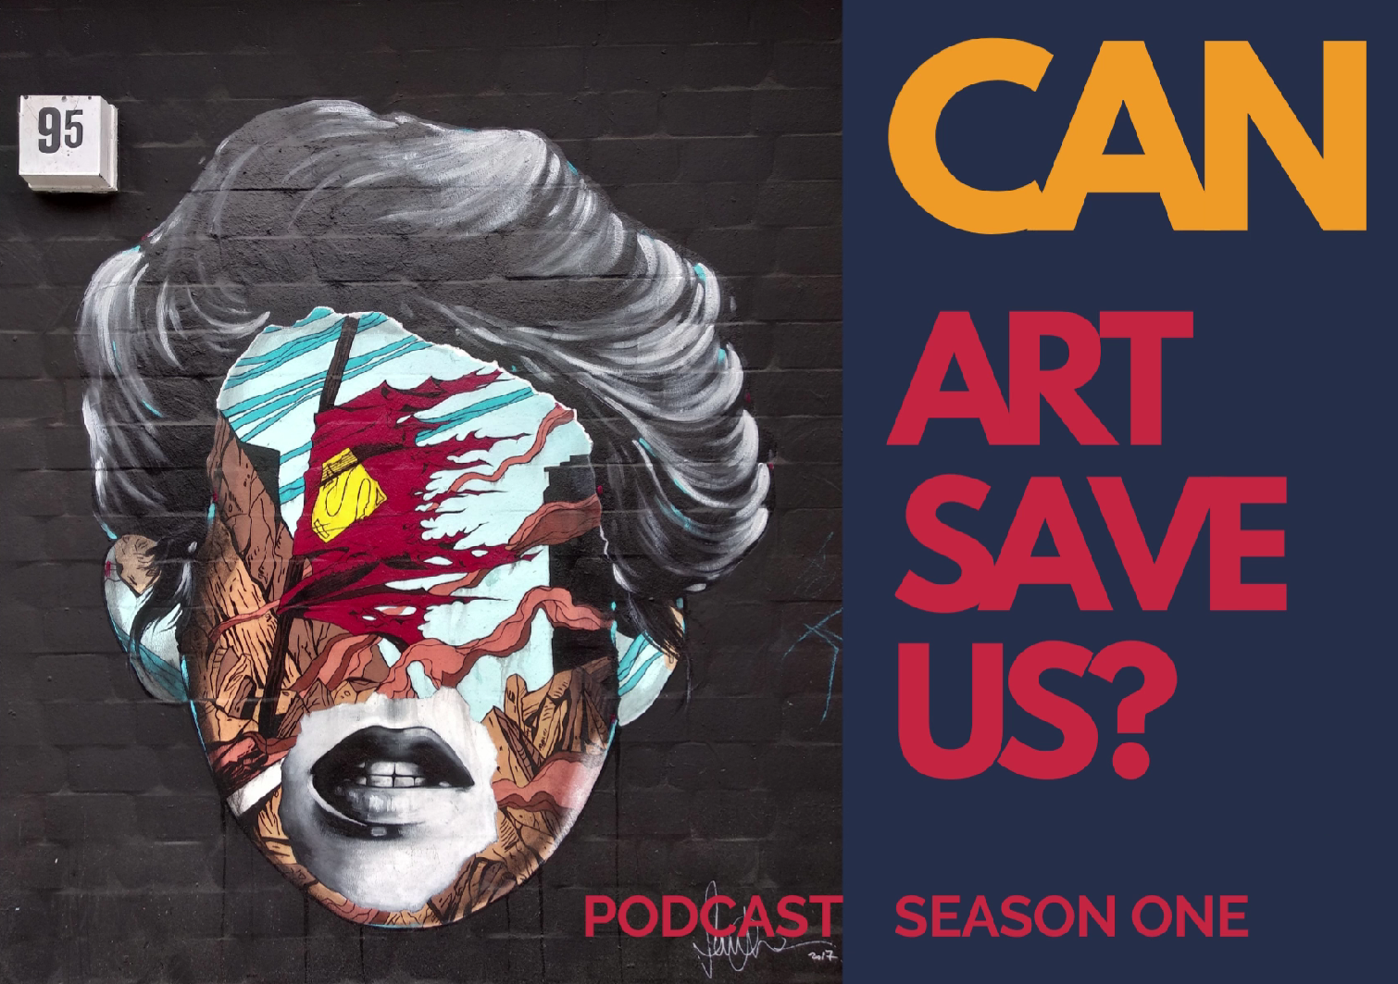
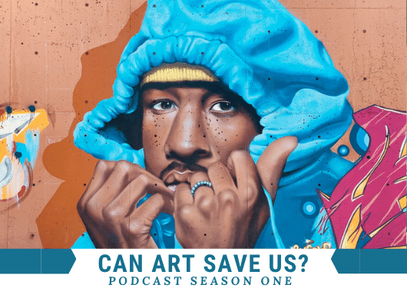
COVERAGE AND CONTACTS
Your host and producer Paula Moore’s career spans television, arts and education. She has interviewed music legends including Ray Charles, Curtis Mayfield and Quincy Jones along with A list actors. She has been interviewing diverse and international artists over the last five years.
BBC Radio Sussex interview with Paula and guest Antony Penrose. July.
Sussex Newspapers / Online syndication, confirming dates.
BBC Radio Tees, the Upload Show. Includes Tees based Kitt, Lady Kitt.
Creativity & Wellbeing Week 16th-22nd May, 2022 Can Art Save Us? Listed as an online event.
https://creativityandwellbeing.org.uk/listing/can-art-save-us-podcast-season-one/
Mental Health Awareness Week 9-15th May, 2022
WWW.CANARTSAVEUS.COM
Twitter / Instagram @canartsaveus
LinkedIn https://www.linkedin.com/in/canartsaveus/
paula@canartsaveus.com 07999751992
Associations / Research Partnerships
Arts & Wellbeing Centre, Brighton University
Schools of Health / Creative Industries, Canterbury Christ Church Uni
EU Guide to Social Prescribing for Cultural leaders (Ireland)

