Slide 1


Funding for Creatives
To demystify funding opportunities
Connect you to the right opportunities
Increase your chances of success

Slide 2

SUCCESS in SECURING FUNDING
Like making a cake
Depends on ingredients (you and your project)
& follow the recipe !
STEP ONE – GET TO KNOW THE FUNDERS (all sectors)........

Slide 3


FUNDING OPPORTUNITIES
PRIMING GRANT is a business start-up grant, available to micro enterprises within the first 18 months of start-up. The max Priming Grant payable shall be 50% of the investment. 4 Expenditure headings:
Capital items Salary costs Consultancy/Innovation/Marketing costs General overhead costs
Criteria:
A business which on growth will fit the Enterprise Ireland portfolio
A manufacturing or internationally traded services business
A domestically traded service business with the potential to trade internationally
Deadweight and displacement - WHAT IS SPECIAL ABOUT YOUR BUSINESS IDEA?
All grants of a value greater than or equal to €40,000 need EI approval

Slide 4
FUNDING EXAMPLE
Branding, graphic design and consumer website €1,675.00
Technical realisation of online database €4,680.65
IT requirement, MAC book, IMac & associated software €3,777.19
Insurance (£1750 stg) €2,447.80
Consultancy costs (industry specific contracting expertise) €2,250.00
TOTAL COSTS €14,830.64
Of which 50% grant requested €7,415.32
EMPLOYMENT
2.5 EMPLOYMENT GRANTS based on promoters x 2 and 1 part time Administrator €25,000
TOTAL GRANT REQUEST €32,415.32

Slide 5
FUNDING OPPORTUNITIES
BUSINESS EXPANSION GRANT is designed to assist the business in its growth phase after the initial 18 month start-up period.
Same criteria and funding levels
Business that had availed of a Priming Grant will be ineligible to apply for a Business Expansion grant until 12 months after approval/drawdown date of Priming Grant whichever is the later
PLEASE NOTE – part of the grant is repayable
Typically 30% of your grant amount.
(in the case of our example – 30% of €30,000 = €9,000 is repayable @0% over 3 years = €3,000 p.a.)

Slide 6
FUNDING OPPORTUNITIES
Feasibility/Innovation grants for those investigating new innovative business projects.
Assistance to a maximum of 60% of the research, design, and prototype development costs may be awarded subject to a maximum grant of €10,000*.

Slide 7
THE APPLICATION PROCESS
Contact the LEO for initial chat. www.localenterprise.ie/ your county
Application form, business plan, financial projections, quotations (under €5,000 = 1 quote, over €5k = 3 quotes)
TIPS
The categorisation of your business is very important
If struggling, ask for mentor support
Match funding needs to be in place
As for all funders – compelling business plan is essential.
Grants are payable in arrears on the basis of expenditure (net of VAT) being properly vouched- you need to factor this into cashflow

Slide 8
THE STEPS ….
When assessed by LEO staff, your application will then be presented at the next available Evaluation Committee meeting.
From this point it will take approximately 6-8 weeks for your application to be processed. The Evaluation & Approvals Committee will then make a decision to either approve or reject the application.
Applicants will then be notified in writing of the decision of the committee.
If your application is approved you will receive a letter of offer along with conditions of grant aid and a checklist of how you can claim the grant assistance approved.

Slide 9

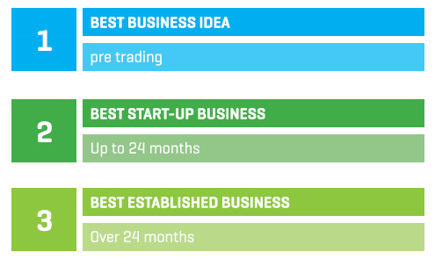
FUNDING OPPORTUNITIES
Under 30 ? It is a really good idea to apply to the Irelands best young entrepreneur competition http://www.ibye.ie/. Each county has a investment fund of €50,000 to award to Category Winners

Slide 10

OTHER SUPPORTS
WORTH TAPPING INTO ….
MENTORING
A panel of business specialists – finance, marketing, technical etc. who contributes independent, informed observation and advice to aid decision making.
Who Qualifies?
The Mentor Programme is open to both new and existing businesses located within the LEO region.

Slide 11
ONLINE TRADING VOUCHER
Applicant business must be registered and trading for at least 12 months;
Vouchers are available to a maximum value of €2,500 or 50% of eligible expenditure (exclusive of VAT), whichever is the lesser;
Must attend an information session
Voucher approval must be gained prior to incurring any expense;
Own labour is not an eligible expense;
Third party costs only will be considered.
https://www.localenterprise.ie/Discover-Business-Supports/Trading-Online-Voucher-Scheme-/2015-LEO-Online-Voucher-Application-Form.pdf

Slide 12
ONLINE TRADING VOUCHER
IT consultation;
Development or upgrade of an e-commerce website;
Implementing Online payments or booking systems;
Purchase of Internet related software;
Purchase of online advertising (this purchase cannot make up any more than 30% of approved Voucher costs and can only be drawn down in one payment phase);
Developing an app (or multiplatform webpages);
Implementing a digital marketing strategy i.e. Social media marketing;
Consultation with ICT experts for early stage adopters of online strategy;
Training/skills development specifically to establish and manage an on-line trading activity.

Slide 13

New Frontiers Programme
New Frontiers is Enterprise Ireland’s national entrepreneur development programme for innovative, early-stage start-ups. The Programme is run by Institutes of Technology and is a three-phased programme, based in 14 campus incubation centres across the country. Each year, New Frontiers funds 150 companies.
You need to prove you can run a sustainable new business, trade internationally, create employment.
Main Benefits of this Programme
De-risk your business model
€15,000 tax-free grant (in phase 2)
No equity taken from your business
Hot-desk and incubation facilities
Introduction to government & private investment opportunities
http://www.newfrontiers.ie/

Slide 14


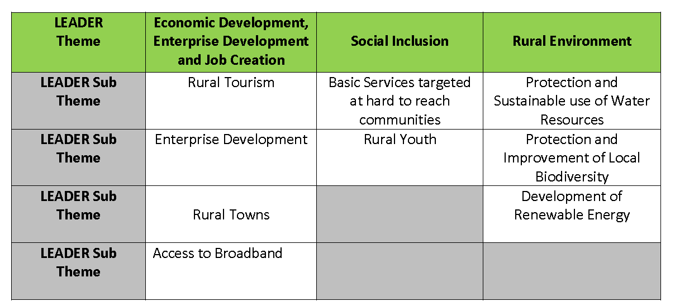
JUST AROUND THE CORNER - LEADER
It is expected that LEADER will fund..
Each County has a Local Development Strategy which may have differing priorities

Slide 15
JUST AROUND THE CORNER - LEADER
Worth noting ..
No repayability
Funds are more limited than previous Leader programme
*Still being finalised but ....
  Maximum grant rate of up private promoters is 50%
  Up to 75% for community organisations
  Training activities may be funded up to 100% - very useful for creative network development
  Benefit in kind may also be used.
  Watch this space for roll out – September 2016 ?
  Expressions of interest

Slide 16


FIND IT HARD TO RAISE MATCH FUNDING ?
REJECTED BY THE BANK?
Can really recommend http://microfinanceireland.ie/
Targeted at start-up or growing microenterprises across all industry sectors (includes retail)
Provide unsecured business loans of €2,000 to €25,000 for commercially viable proposals that have been declined bank credit.

Slide 17
FIND IT HARD TO RAISE MATCH FUNDING ?
REJECTED BY THE BANK?
Based on business plan –everything comes back to the business plan
Term from 3 to 5 years
Reduced Interest Rate 7.5% (7.8% APR) for LEO clients
Flexibility on repayment terms
Successful applicants
http://www.niamhdesignstudio.com/
http://www.cellmedia.ie/
http://www.player1.ie/

Slide 18

WDC Micro-Loan Fund: Creative Industries
The WDC provides micro-loans of €5,000-€25,000 to creative industry businesses for periods of 3-5 years. http://www.wdc.ie/wdc-investment-fund/micro-loan-fund/
Western Development Commission
Gillian Buckley, Investment Manager,
gillianbuckley@wdc.ie

Slide 19


BACK TO WORK
ENTERPRISE ALLOWANCE
Back to Work Enterprise Allowance (BTWEA) scheme:
allows those embarking on self employment to retain some existing welfare benefits while setting up a new business. If you take part in the Back to Work Enterprise Allowance scheme you can keep a percentage of your social welfare payment for up to 2 years
Note - Local Integrated Development Company or a Facilitator has approved in writing in advance
http://www.welfare.ie/en/downloads/sw92.pdf

Slide 20

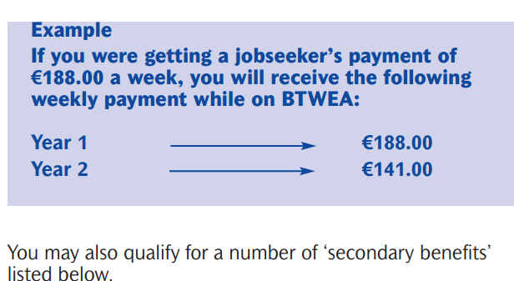
FUNDING OPPORTUNITIES
Back to Work Enterprise Allowance (BTWEA) scheme:

Slide 21
FUNDING OPPORTUNITIES
Back to Work Enterprise Allowance (BTWEA) scheme:
Extra supports, for example grants for training, market research, business plans or book-keeping and access to loans to buy equipment.
You may also get assistance in paying for public liability insurance - either €1,269.74 or 50% of the cost, whichever is lower

Slide 22

STILL EMPLOYED ?
NEW 'Start-Up Relief for Entrepreneurs' (SURE) scheme
PAYE workers who opt to start up their own business may be entitled to income tax refunds (going back up to 6 years) of up to 41pc of their capital investment up to a cap of €100,000.
http://www.revenue.ie/en/tax/it/leaflets/it15.html

Slide 23

CREATIVE SECTOR SPECIFIC FUNDING .....

Slide 24

http://www.dccoi.ie/craftspeople/opportunities/type/upcoming
External Exhibitions Fund
The External Exhibitions Fund has been established to assist the development of high-quality, independent exhibitions run by individuals, organisations or groups. This annual fund supports a small number of professionally produced exhibitions featuring Irish design/craft in Ireland or abroad.
International Fair Fund
The International Fair Fund has been developed to financially assist designers/craftspeople in reaching key export markets. The fund provides limited match funding for wholesale trade fairs abroad.

Slide 25


Future Makers Awards & Supports
DCCoI’s Future Makers Awards & Supports programme rewards the next generation of creative makers, providing support for development of an exciting career in the craft and design industry. The programme funds research, training, residencies, exhibitions, studio development and more. www.futuremakers.ie

Slide 26
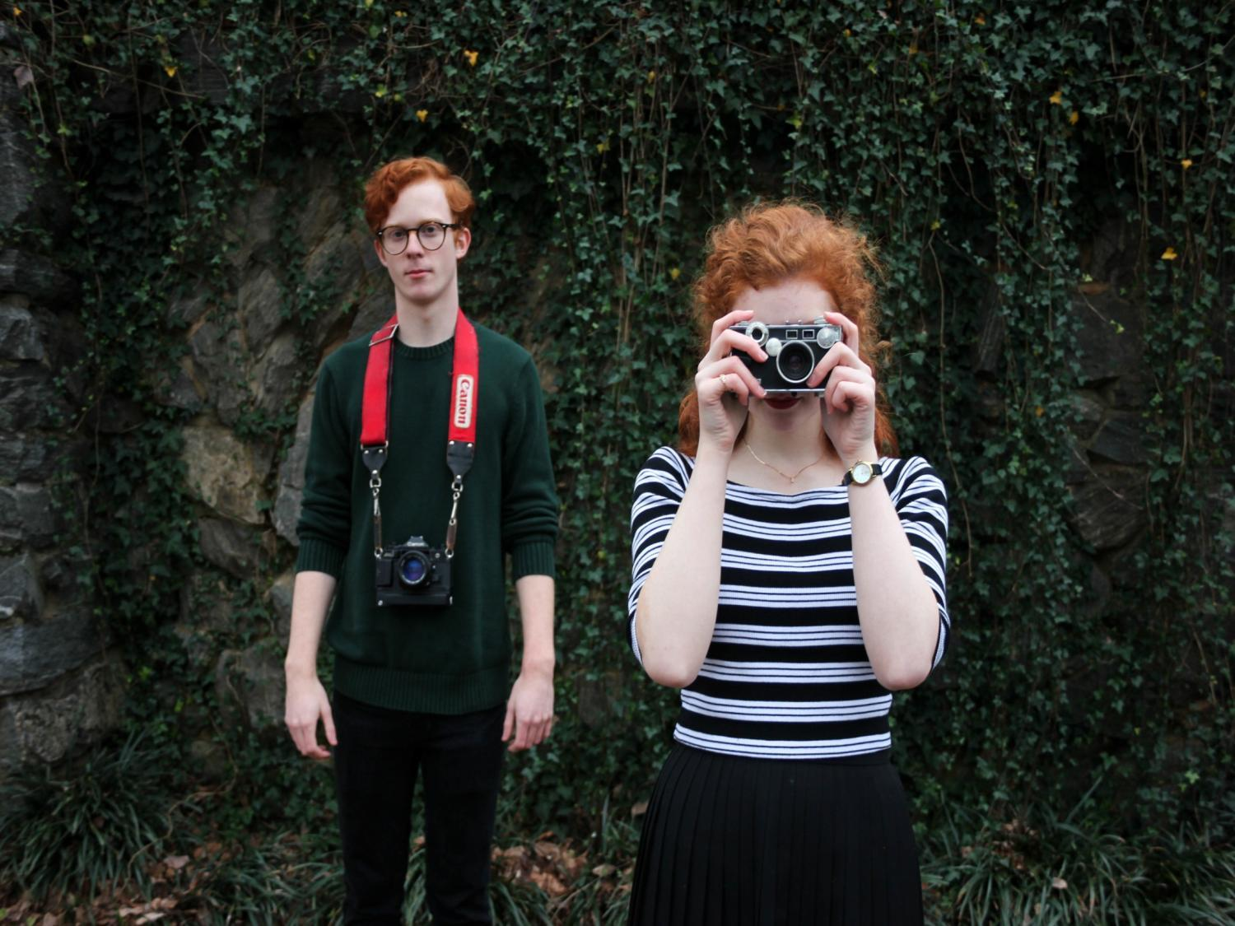

Arts organisations, artists, and groups working with the arts can apply for funding. Discover what funding is available then register for online services to submit an application.
http://www.artscouncil.ie/available-funding/

Slide 27

An innovation programme funded by a creative momentum project. It matches emerging creative talent with existing businesses over a 10-day period in order to facilitate innovation. The programme will be repeated four times between 2016 and 2017.
To apply - Login to MyCreativeEdge and complete the online application form. If you are not already registered on MyCreativeEdge, you will need to register here.
Download
Creative Steps 2.0-App Form in Word for download (Word)
Creative Steps 2.0-App Form in PDF for download (PDF)

Slide 28

A continuous professional development network designed to facilitate the ongoing training and development requirements of practitioners in the creative sector in Leitrim and the wider region.
http://creativeframe.eu/

Slide 29


FREE course to help creative entrepreneurs to set up online and sell in 30 days
CONTENT
This programme has been funded with support from the European Commission

Slide 30
European Commission - Creative Europe:
Creative Europe is the new framework programme for the cultural and creative sectors for 2014-2020. The programme will target the needs of the cultural and creative sectors, particularly in terms of promoting jobs and growth potential, and will promote cultural and linguistic diversity.
Supports transnational cooperation projects, European networks, literary translation and European platforms.
Who Can Apply
Professionals, organisations, businesses and institutions active in the cultural and creative sectors will be eligible to apply. The cultural and creative sectors include: architecture, archives and libraries, artistic crafts, audiovisual (including film, television, video games and multimedia), cultural heritage, design, festivals, music, performing arts, publishing, radio and visual arts.
Useful Links - Creative Europe
http://ec.europa.eu/programmes/creative-europe/index_en.htm

Slide 31

Partnerships for cooperation projects must consist of a minimum of three different partners, from three different countries (for small cooperation projects) and at least six different partners, from six different countries (for large cooperation projects).

Slide 32
European Commission Creative Europe - Culture
Useful Links
Creative Europe - Culture Programme
http://ec.europa.eu/culture/tools/culture-programme_en.htm
Creative Europe Desk UK
http://www.creativeeuropeuk.eu/
EACEA - Creative Europe Calls
http://eacea.ec.europa.eu/creative-europe/funding_en
Useful Contacts
Creative Europe Desk for Culture
Directorate General for Education and
Culture, British Council, 10 Spring Gardens, London, SW1A 2BN
E-Mail:
creative.europe@britishcouncil.org
Calls and deadlines
Information on future calls is indicative only and may be subject to change.
European Platforms
Application start date: -
Application end date: 05/10/2016
Cooperation Projects
Application start date: -
Application end date: 05/10/2016
European Networks
Application start date: -
Application end date: 05/10/2016
Support to literary translation projects 2016 (EACEA 13/2016)
Application start date: 08/03/2016
Application end date: 27/04/2016

Slide 33

European Commission Creative Europe - MEDIA
The MEDIA Strand of the Creative Europe programme supports the EU film and audiovisual industries in the development, distribution and promotion of their work. Maximum value: € 1,000,000
Who Can Apply
Organisations, businesses and institutions active in the film and audiovisual industries are eligible to apply. This includes:
Independent production companies
Independent audiovisual production companies
European cinema / theatrical distributors
European entities - private companies, non-profit organisations, associations, charities, foundations, municipalities or Town Councils

Slide 34
Heard about crowdfunding ? ?

Slide 35
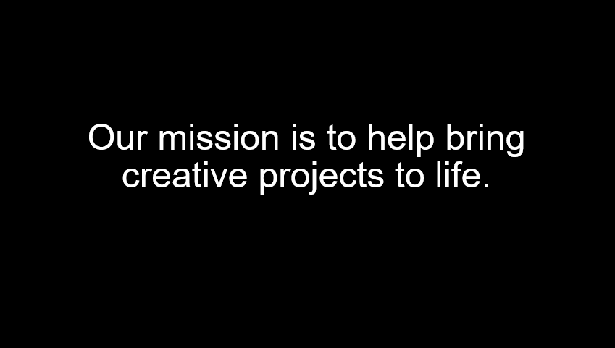
www.kickstarter.com

Slide 36
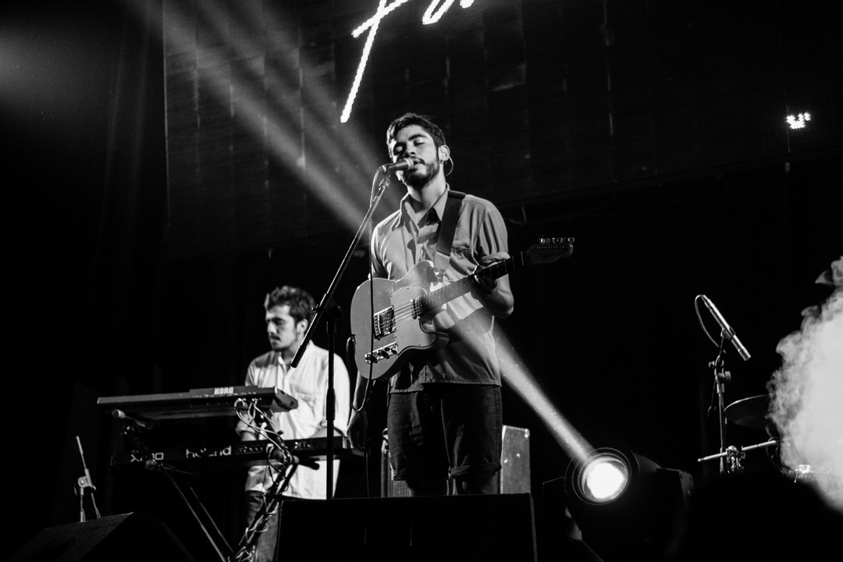
www.kickstarter.com
Kickstarter helps artists, musicians, filmmakers, designers, and other creators find the resources and support they need to make their ideas a reality.
Kickstarter is an enormous global community built around creativity and creative projects.
Local projects benefitting
https://www.kickstarter.com/discover/places/galway-ie

Slide 37
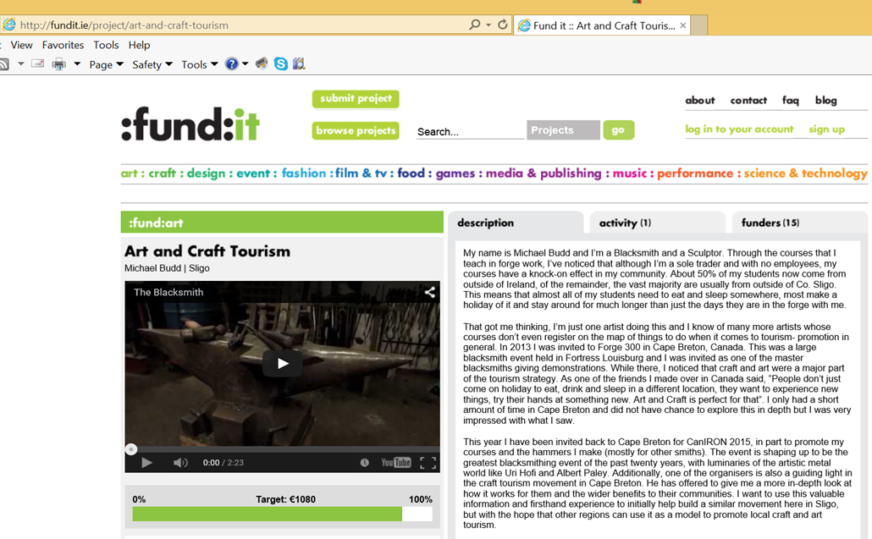
HEARD ABOUT CROWD FUNDING ?

Slide 38

CROWD FUNDING PLATFORMS
iCrowdFund:
An Irish crowdfunding company from the same people that developed iDonate and iFundraise
Rate: 4% commission Website: www.icrowdfund.ie
Fundit:
An Irish owned not for profit organisation working to support resilience and transformation in the cultural sector.
Rate: 5% commission Website: fundit.ie
Linked Finance:
Another Irish owned crowdfunding site with favourable commission rates. Rate: 2.5% commission
Website: www.linkedfinance.com

Slide 39
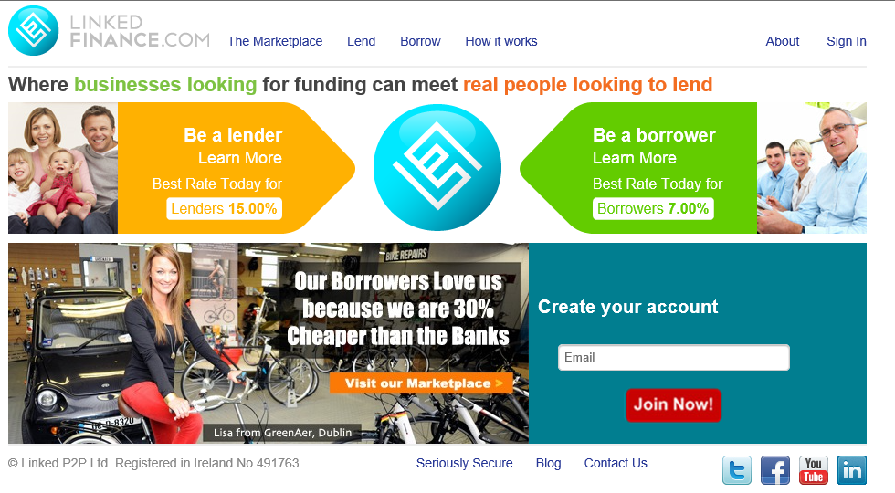
Linked Finance:
www.linkedfinance.com

Slide 40

5 Ways to Improve Your Next Grant Application.
1 FORGET ABOUT THE MONEY! (AT LEAST INITIALLY…) & DEFINE YOUR PROJECT
The primary concern of funders is that your project is well planned and that it will truly make a difference.
In making an effective application important questions to start with include:

Slide 41
5 Ways to Improve Your Next Grant Application.
‘What are you trying to achieve?’
New workshop space, purchase new equipment ?
Make a new body of work
go on a course/ do some training etc
‘How does your project fulfil the funder’s aims?’
Link your project to the funder’s key criteria and show how your project furthers their aims and objectives.
What are the real and positive differences the funding will make?

Slide 42
2 - DO YOUR RESEARCH THOROUGHLY…
Up to 50% of applications received by funders do not meet their published criteria
As a very basic minimum you should read the guidelines published by the funder.
Consider: Who the funder is, What their motivation for funding is, The format for applying, The level of funding, Submission deadlines, Eligibility, Decision making process

Slide 43
3. REMEMBER – ‘PEOPLE GIVE TO PEOPLE…’
Be creative, challenging and engaging about your idea, this is your opportunity to distinguish yourself from the competition.

Slide 44
4. Build your credibility and be professional!
One of the primary reasons why applications get funded is that the funders are convinced that the applicant organisation is well organised, has a good track record and is a capable promoter to carry out the proposed project.
You approach the creation of your work with a high degree of professionalism – approach the generation of proposals in the same way.

Slide 45
5. Ask yourself, ‘Why wouldn’t they fund this?
Often a good way to strengthen your funding application is to try and ‘pick holes’ in it. Having identified the weaknesses you can then work on putting them right.

Slide 46

..THE BUSINESS PLAN ..
Clear outline of the project;
Details on Promoter’s background including work experience, educational achievements and any particular qualifications held plus technical knowledge in sector;
Details of investment planned;
(This should include a description of any building proposed and a list of equipment to be purchased including prices of each item exclusive of VAT).

Slide 47
..THE BUSINESS PLAN ..
Details of existing and proposed employment levels;
Markets - this should include a list of existing and potential customers for the products/services proposed and identification of existing competitors.
Financial details including:-
Projected Profit & Loss Account and Balance Sheets
Source of balance of finance required for the project – own funds, bank finance , investor capital available and other .

Slide 48
If the recipe isn’t right > Use rejections as a learning experience
Everybody gets rejections from grant funders at some time, learn from your mistakes:
Ask for feedback- even if your rejection letter specifies a reason for your rejection, asking for verbal feedback will sometimes bring you a fuller and more open response.
Reflect on your approach – be honest with yourself. Did you rush the application? Did you really think you met the priorities or were you spinning things a little?
Find out what did get funded – funders often publish lists of what they did fund. What do you notice about the projects that got funded? Were the creatives at a different stage of their career to you? Were you asking for much more (or less) money than they received? Were you applying for activities that this funder hasn’t supported?

Slide 49

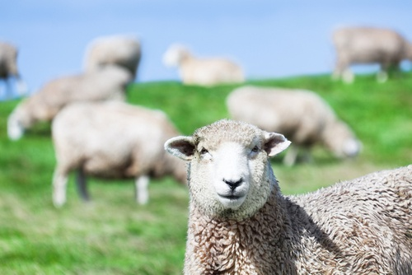
Contact details
Orla Casey
(e) orla@momentumconsulting.ie
MOMENTUM IMAGERY
- WHY SHEEP ?
Gregarious in nature, but somewhat stubborn. Sheep need guidance on where to go, other wise they'll wander off and get lost!

